Slide 1
Shallow Water Equations
Diong Jeong Yik

Slide 2
Objective
A model to simulate the Shallow Water Equations.
Programming language : FORTRAN (SWE), python (visualization).

Slide 3
Shallow Water Equations
In the atmospheric science, the shallow water equations are the simplest form of the equations of motion that can be used to describe the horizontal structure of an atmosphere.
They describe the evolution of an incompressible fluid in response to gravitational and rotational accelerations.
The solutions of the shallow water equations represent many types of motion, including Rossby waves and inertia-gravity waves.

Slide 4
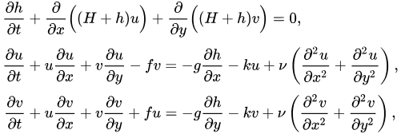
Shallow water equations
The general form of the SWEs are written as below:

Slide 5
Software required
GNU FORTRAN compiler (gfortran)
Netcdf Library
Makefile
Visualizing software – python etc..
Linux based

Slide 6
Numerical methods
Finite Difference Method – Central Difference Schemes
Runge-Kutta Fouth Order Scheme
2D unstaggered grid

Slide 7
Programme Structure
main.f90
(to call all the subroutines and modules)
initial.f90
(contains all the initial conditions)
parameter.f90
(contains all the constants/
variables)
Swe_rk4.f90
(the numerical methods, all calculation will be done here)
saver.f90
(to save the output)
Output (in netcdf)

Slide 8
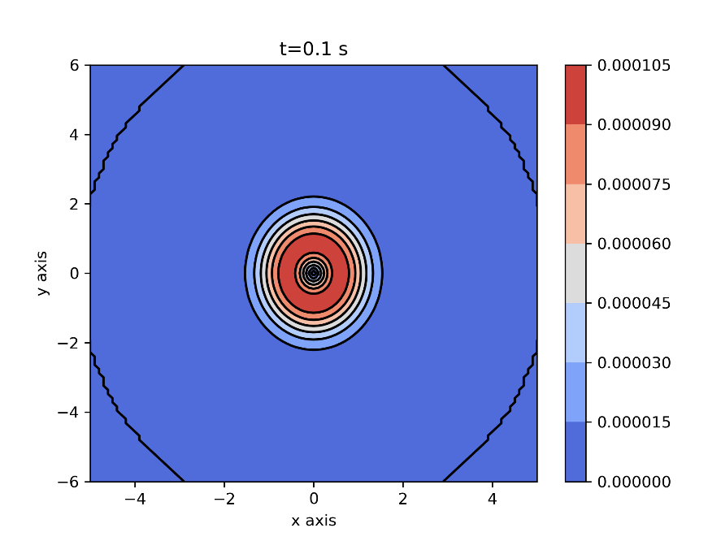
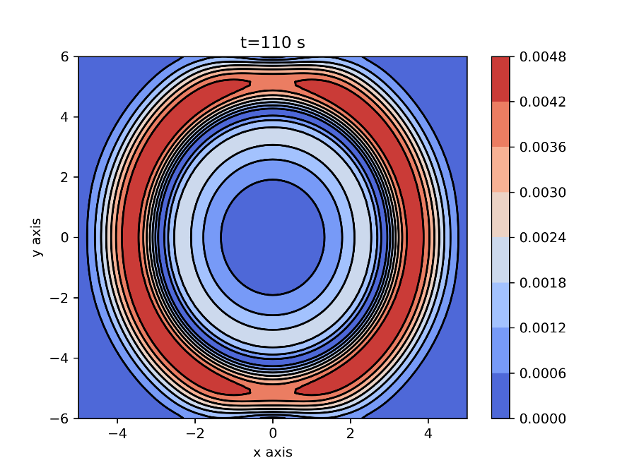
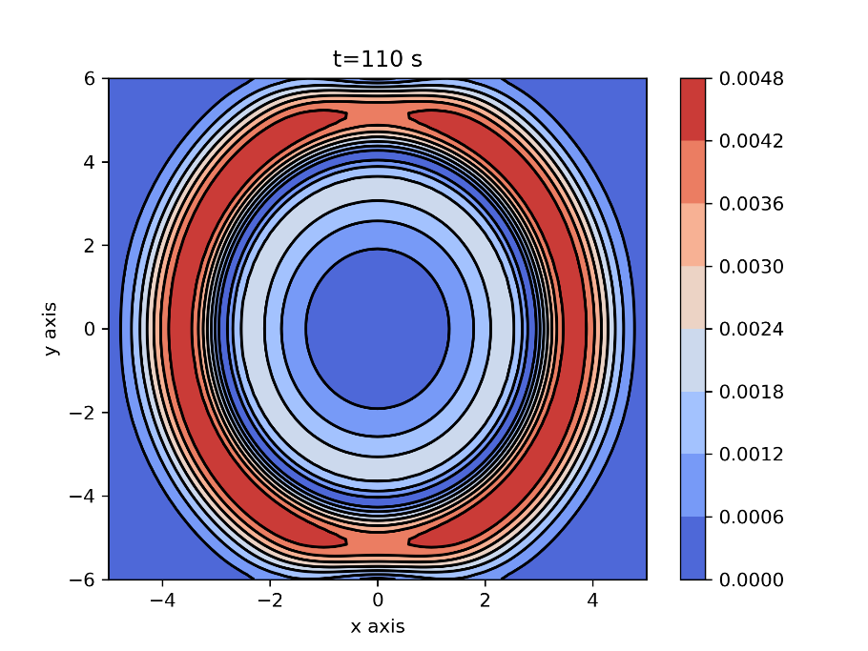
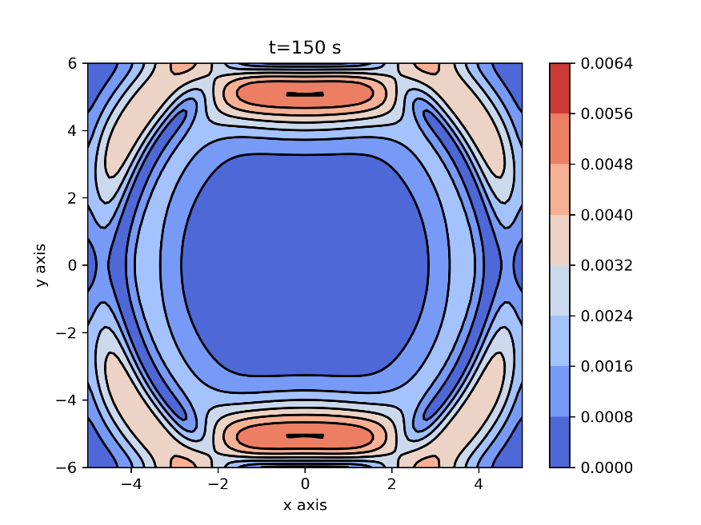
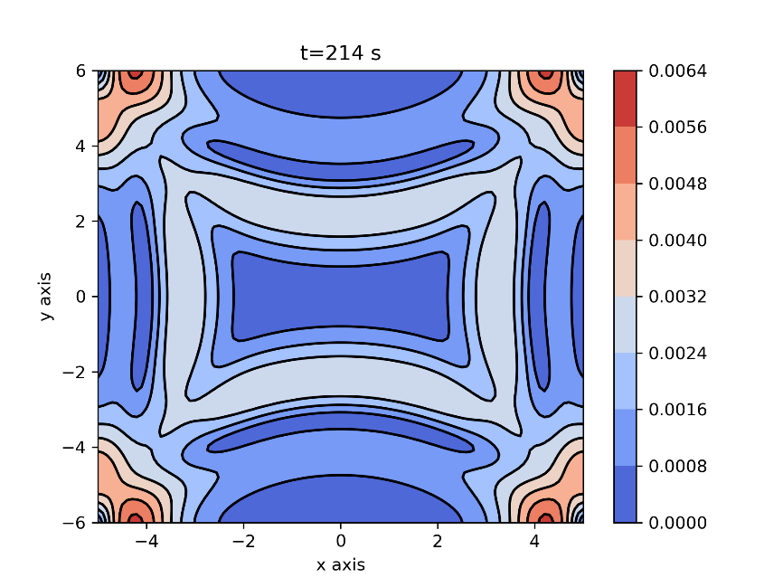
Sample outputs for small rotation (1e-4)

Slide 9
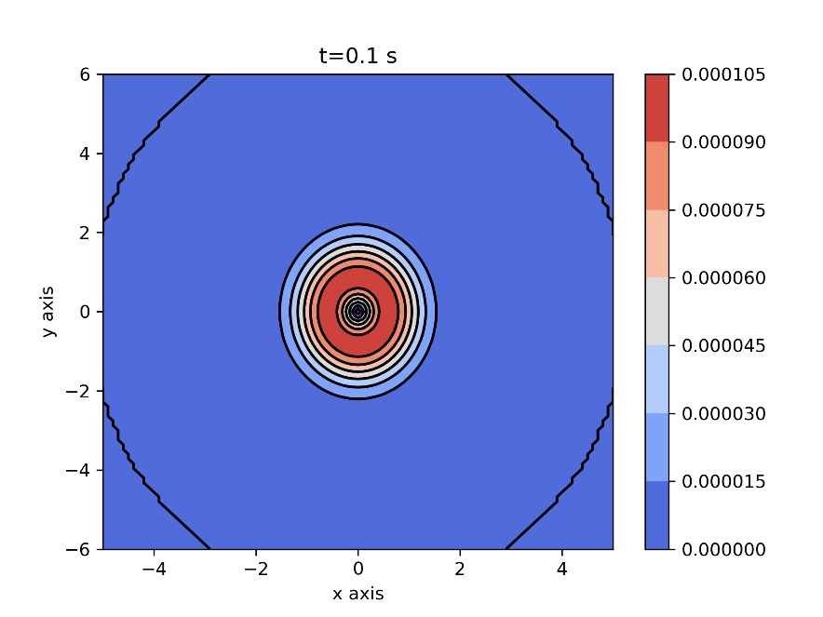
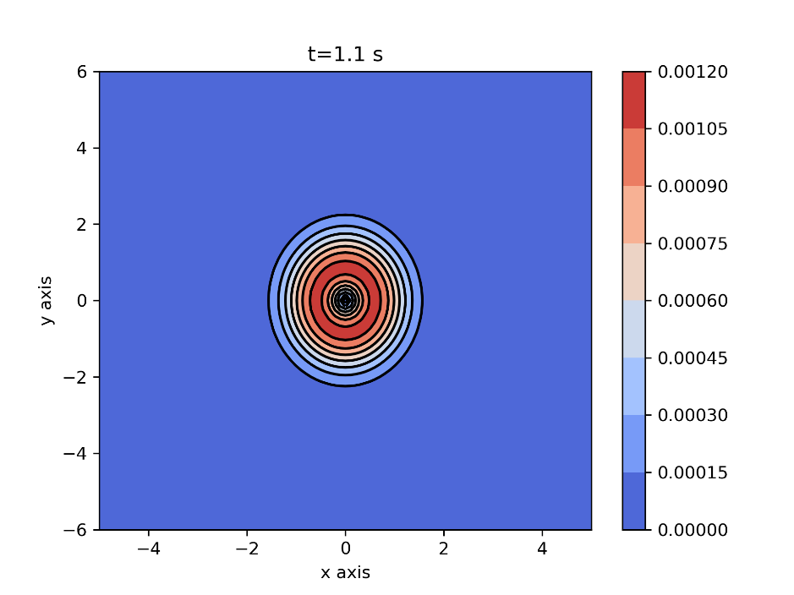
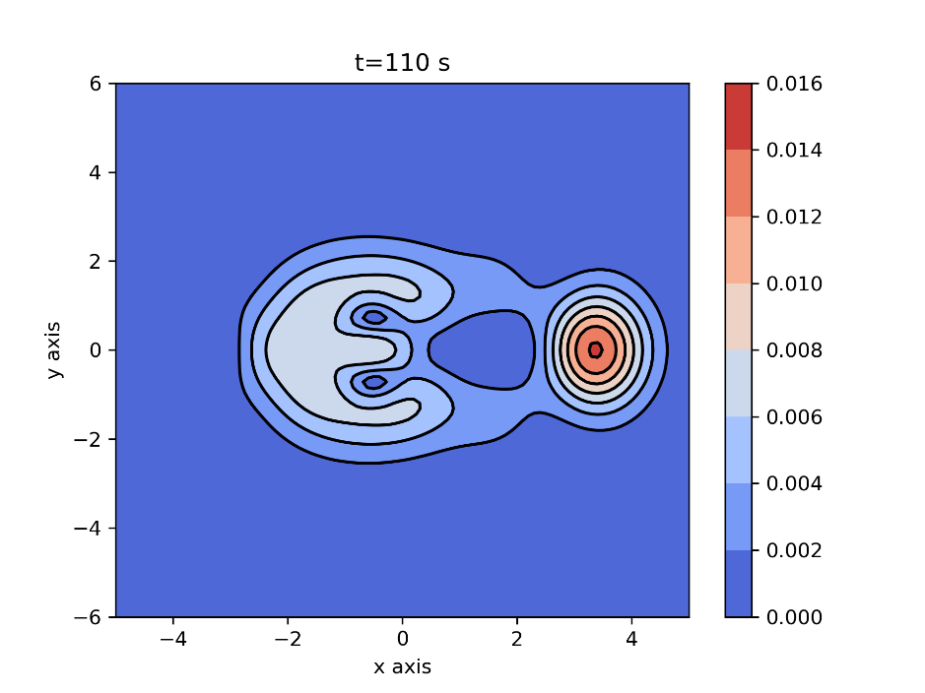
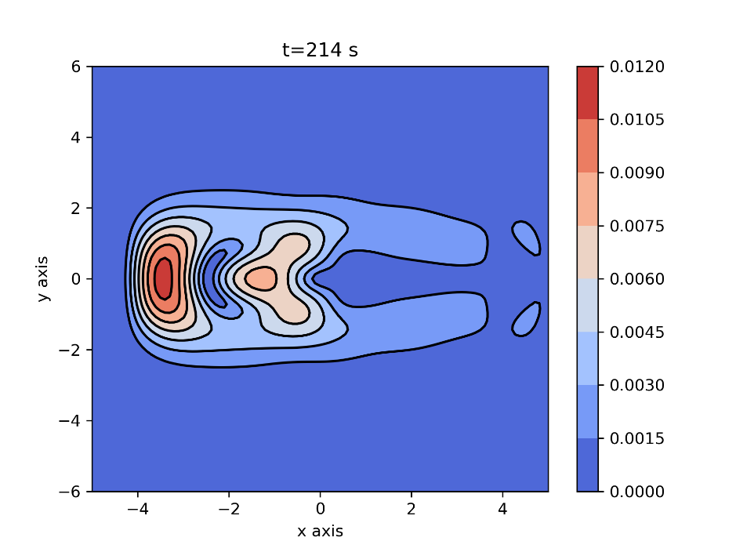
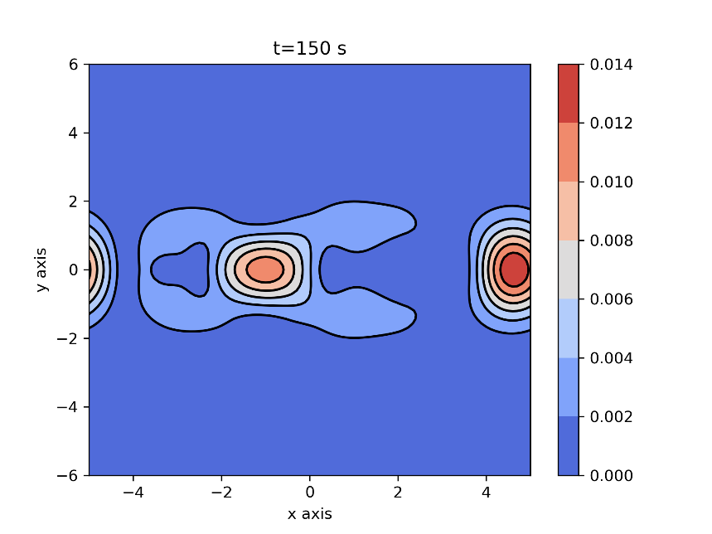
Sample outputs for large rotation (1e-1)

